Slide 1
How-to transition from using paper forms to completing all supervision electronically through Certemy
Q&A’s
LABSWE
OCTOBER 2021

Slide 2
LMSWs gaining supervision hours before applying for the LCSW Q&A’s
LCSW Application
Phase 1- Supervision

Slide 3
What should I do first if I am currently in Supervision?
Anyone currently in supervision should start the LCSW application.
Why?
Starting the LCSW application will bring you into Phase 1 and will allow you to keep track of your supervision just like it was done on paper forms.
This way all of your supervision is already on your application when you are finished and do not need to turn anything else in when you are finished and ready to apply.
Starting the application is not applying for the LCSW. Starting the application is a prerequisite before applying for the LCSW.

Slide 4
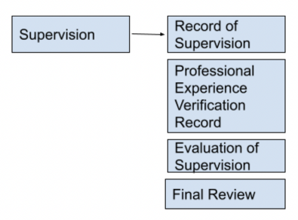
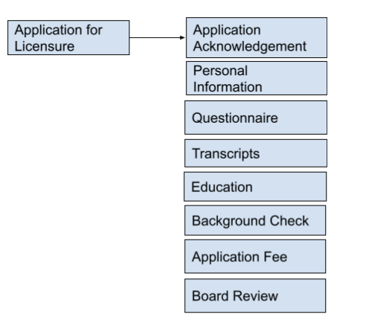
Complete the Supervision Contract to get supervision approval for any new change from your original contract.
Start the LCSW application to keep track of your Supervision (Phase 1 of the LCSW application). When your supervision is complete, you will be transitioned into Phase 2: Application.

Slide 5
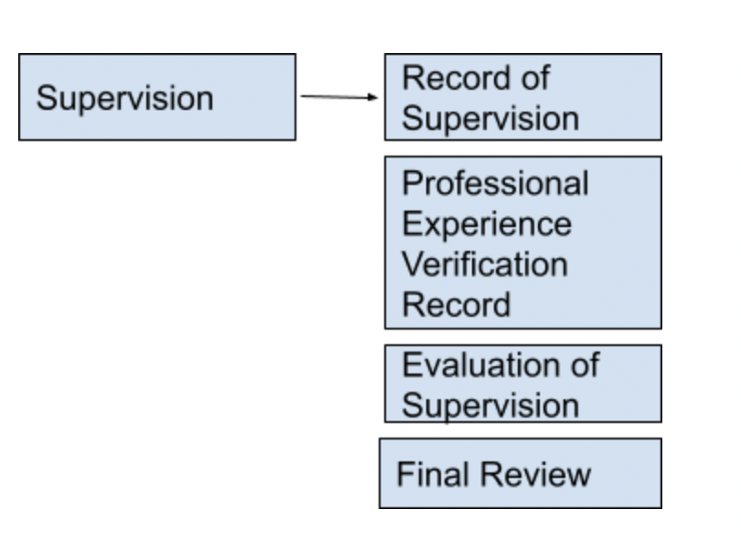
LCSW Application- Phase 1
Starting this LCSW application in Phase 1 allows you to log your supervision and work hours while working towards the LCSW.
All of the forms normally filled out on paper during supervision will be logged in this Phase.
This phase will allow you to see on your application how many hours are left as hours are logged.
This phase of the LCSW application will help assure you that your supervised hours, work hours, and evaluations are recorded and that you are not missing anything needed for supervision.

Slide 6
Phase 1- Supervision: Record of Supervision
Licensee- After your first supervisory session, invite your supervisor to either 1 or 2 hours through the Record of Supervision step to sign off on your first session.
Supervisor- Accept and sign off on the session. When you are done, click close window. This will allow you to click ‘add record’ to log every session through your Supervisor profile.
LCSW-BACS:
Do NOT click confirm log until you are finished all 96 hours of face to face supervision or you are terminating supervision with your supervisee.
If supervision between an LMSW and LCSW-BACS ends before the required hours are met, the supervisor will need to confirm log and the supervisee will need to invite the their supervisor to complete the Evaluation of Supervision step to terminate supervision.
Do not invite your supervisor to all 96 hours. Start off small by inviting your supervisor only for the initial meeting. It is not recommended to invite your supervisor to all 96 face-to-face hours because supervision may terminate before the 96 hours and then you will not be able to invite another supervisor to log your hours.
Submit another Supervision Contract and once the contract is approved, you may invite your new LCSW-BACS to the record of supervision step to log your initial session

Slide 7
Phase 1- Professional Experience Verification Record
LMSWs will need to invite their employer to complete this step.
This step should be completed when a LMSW terminates employment or when the LMSW has their total hours.
If the application is being completed in 2021, the Board will be looking for 5,760 hours total.
If the application is being completed in 2022, the Board will be looking for 3,000 hours total.
Licensees- Invite new or past employers to verify the number of hours you were employed there.
Invite your employer when you are no longer working for the agency or you are finished with supervision.
It is recommended to invite your employer 1 hour total.
Your employer will be able to log the correct hours worked

Slide 8
Phase 1- Evaluation of Supervision
You will be able to invite 1 supervisor on this step to complete the Evaluation of Supervision
If you have more than 1 supervisor, you will need to email maddy.andras@labswe.org to be assigned an Evaluation of Supervision workflow.

Slide 9
What should I do first if I am done with Supervision but have not yet started the LCSW application?
Anyone finished with supervision should start the LCSW application.
Why?
You will need to have all of your information on this application in order to complete the steps to apply for the LCSW.
Invite your employers to fill out the Professional Experience Verification Record and Supervisors to fill out the Evaluation of Supervision and the Record of Supervision.
Once all of the steps are pending verification, your supervision will be reviewed and approved.
Once your ‘Final Review’ step is reviewed and approved, you will be moved into Phase 2- Application for Licensure.
You will then complete the application and once all of the steps are approved and your background check results are in, your application will be ready for Board review.
Once the Board reviews your Application, you will will be moved into Phase 3- Examination and will receive approval to take the Clinical Exam.

Slide 10
Q: How do I start logging my Supervision on Certemy?
Q: Is each individual session now documented into Certemy?
EXAMPLE SCENARIOS
A LCSW-BACS and a LMSW are actively in supervision and are trying to transfer their hours to be visible in Certemy. They have completed 90 face to face hours so far out of the required 96 completed on the paper form. How are they going to transfer their hours over to Certemy?
The LMSW will start the LCSW application and will be started in Phase 1- Supervision. The LMSW will invite their LCSW-BACS to 90 hours on the Record of Supervision step. Their BACS will complete the form and sign off on the 90 hours by clicking submit. The supervisor will click ‘close window’ when finished signing off on the 90 hours to complete the transfer from paper. For the remaining hours, the BACS will click ‘add record’ and will track the rest of the supervision sessions each time they meet. The LMSW can upload a copy of the Record of Supervision form from their previous hours on paper into their digital wallet as proof.
A LMSW is finished with Supervision and unsure how to apply for the LCSW on Certemy since all of their supervision is complete on paper. They do not want to start over.
The LMSW will need to upload their forms into their digital wallet and have their BACS and employer(s) sign off on their hours from their paper forms on the LCSW application.

Slide 11
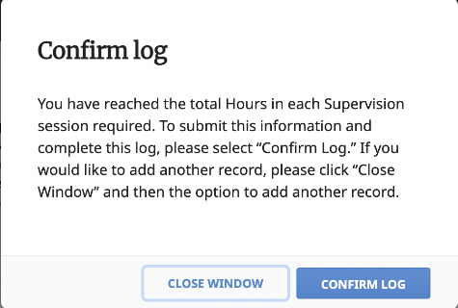
Example Scenarios cont’d
LCSW-BACS:
Do NOT click confirm log until you are finished completely with hours or supervision is terminated. You will not be able to log any more.
Instead, click ‘close window’ after each log you enter.
A LMSW is ready to apply for the LCSW but has had more than one supervisor in the past. The Evaluation and Record of Supervision for their BACS has been turned in previously to the Board. Do they need to invite their previous supervisor to complete the Record of Supervision and the Evaluation of Supervision step on the LCSW application?
Yes, if a supervisee has had previous supervisors, they will invite their supervisor to sign off on the hours already received by the Board.
Invite every supervisor you have had to complete the Record of Supervision and the Evaluation of Supervision on the LCSW Application.
When BACS are transferring the hours over, they initially can log what is done on paper so far. This way, the bulk of the hours done on the paper Record of Supervision can be transferred to Certemy.
Supervisee should upload a copy of the form used previously into their digital wallet
After the initial mass transfer, BACS can log each session as they go.

Slide 12
Q: My supervisees are keeping record the “old school way” (printed out form, filled out by them at every session). I don’t see anywhere on my supervisor profile on Certemy where I would need to be the record keeper of that.
A: As a supervisor, you will not be able to track your face to face hours on Certemy until your supervisee starts the LCSW application when they start supervision. Your supervisee will invite you to complete the Record of Supervision and you will be able to log each session through your Supervisor profile.
If you have previous hours with the same supervisee that were logged on paper, your supervisee can invite you to sign off on the total hours completed so far. You will complete the form on your profile, sign, and click submit.
Your supervisee can upload the paper form into their digital wallet for proof if you are mass transferring hours over. This is so you do not need to log each individual session completed previously

Slide 13
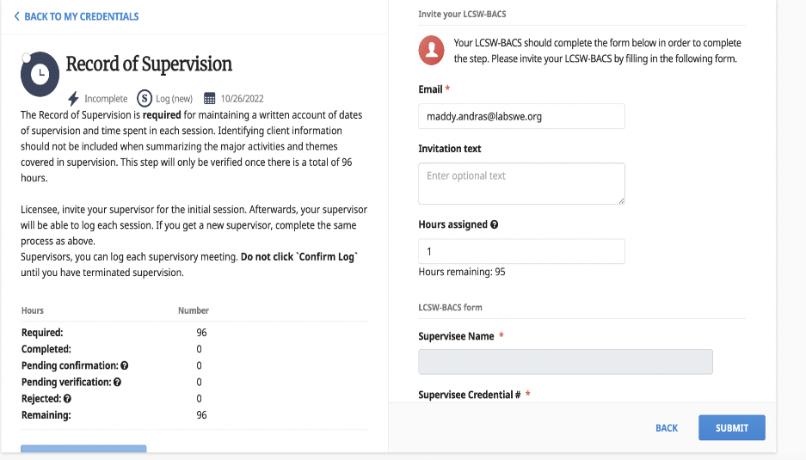
Q: What if I am halfway through supervision? Can I use the paper forms still or do I need to switch to all online?
A: All supervision should be completed through Certemy as of January 1, 2022.
If you are halfway through supervision, you will be able to mass transfer the hours you already have on paper.
If this is your case, you will invite your supervisor on the Record of Supervision step however many hours you had so far that was already logged on your paper.
If you have 46 hours already when you are transferring your hours to Certemy, invite your supervisor to complete 46 hours. Your supervisor will be able to confirm the 46 hours and sign off on those hours. Afterwards, your supervisor will electronically log each session the two of you have.

Slide 14
Q: Are all forms now required to be uploaded in Certemy?
A: All forms should be uploaded into your digital wallet if not already turned in to the Board, but you will need to complete everything via Certemy to have your hours show on Certemy.
Q: Is an email of a copy of the forms also required, requested, or recommended?
A: All forms that have been turned in previously is already in licensees file, therefore, it is not mandatory to upload forms into your digital wallet unless you prefer to or have not turned in yet.
Q: When is the cutoff date for which paper forms can no longer be used?
A: As of January 1, 2022, the Board will not be accepting paper copies of forms.
Q: Are those who have already initiated their supervision with the “old” paper or computerized log grandfathered in?
A:These forms can be submitted into your digital wallet as proof and completed through Certemy as a mass transfer of hours done by your Supervisor.

Slide 15
Q: I have a supervisee who is applying to take her test and the system is prompting a line-by-line entry for each past supervision session
Supervisee- invite your Supervisor to 1 hour and your supervisee will log how many hours have been completed so far on paper.
You should then upload your paper form into your digital wallet.
Supervisor- after you essentially “sign-off” on the hours from paper, you can log each session electronically going forward
A: If you have previous hours with the same supervisee that were logged on paper, your supervisee can invite you to sign off on the total hours completed so far. You will complete the form on your profile, sign, and click submit.
Your supervisee can upload the paper form into their digital wallet for proof if you are mass transferring hours over. This is so you do not need to log each individual session completed previously.
Once Supervision is complete, your supervisor will invite you to sign and submit the Evaluation of Supervision form.

Slide 16
Q: I am hoping for clarification of the process for supervisees who were already engaged in active supervision prior to the transition to Certemy.
Specifically what forms (if any) need to be uploaded now and upon completion of supervision?
Will we only need to upload the termination paperwork (eval,record of supervision,etc) with presumably the initial paperwork already being uploaded by the board?
A: All forms can be transferred easily by mass transferring hours over. If all hours were done on paper, the LMSW can upload copies of the forms into their digital wallet and the Supervisor can technically “sign-off” on the hours through Certemy.
Example-
A LCSW-BACS and a LMSW are actively in supervision and are trying to transfer to Certemy. They have completed 90 face to face hours so far out of the required 96 on the paper form. How do they transfer over?
The LMSW will start the LCSW application and will be started in Phase 1- Supervision. The LMSW will invite their LCSW-BACS to 90 hours on the Record of Supervision Step. Their BACS will complete the form and sign off on the 90 hours by clicking submit. The supervisor will click ‘close window’ when finished signing off on the 90 hours. For the remaining hours, the BACS will click ‘add record’ and will track the rest of the supervisory sessions after each meeting. The LMSW can upload copies of the Record of Supervision from previous hours into their digital wallet.

